Slide 1
A network meta-analysis of interventions for retinopathy of prematurity
Tim Disher, BScN, RN, PhD Student
Co-Supervisors: Dr. Marsha Campbell-Yeo, Dr. Ruth Martin-Misener
Contact Information:
Tim.disher@dal.ca

Slide 2
RETINOPATHY OF PREMATURITY
BACKGROUND
Serious eye disease associated with preterm birth Jefferies & Canadian Paediatric Society: Fetus and Newborn Committee, 2016
Causes blindness if untreated
Related to immature vasculature of the retina
Estimated Canadian prevalence of 37/100 infants born at 32 weeks GA or less Shah, Yoon, & Chan, 2014
Notes:
Part of Coursework

Slide 3
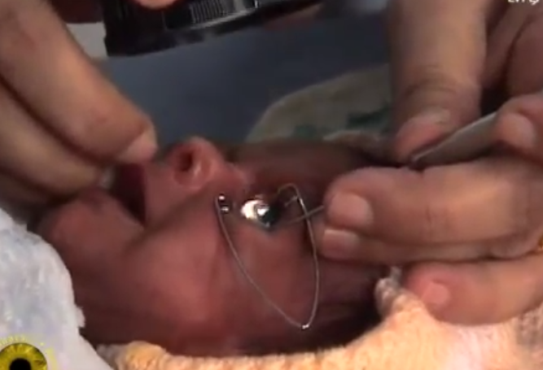
PREVENTION OF ROP
BACKGROUND
Canadian Paediatric Society guidelines recommend serial eye exams for all infants born less than 31 weeks GA as well as infants less than 1250g. Canadian Paediatric Society, 2016
Standard approach includes the use of speculum and scleral depression.
Notes:
Part of Coursework

Slide 4
EXISTING REVIEWS
BACKGROUND
Notes:
Part of Coursework

Slide 5
RESEARCH GAP
BACKGROUND
Notes:
Part of Coursework

Slide 6
Network Meta-analysis primer
Notes:
Part of Coursework

Slide 7
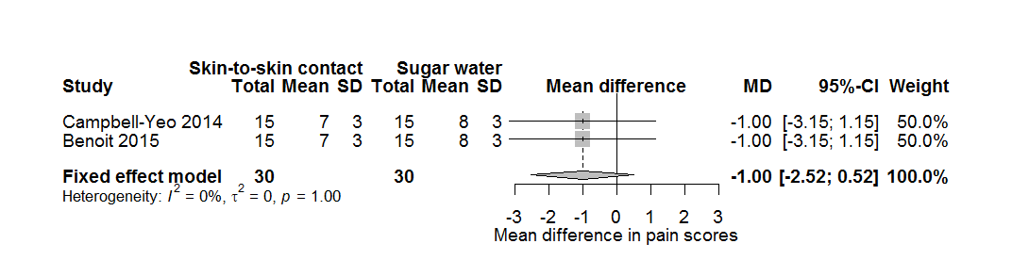
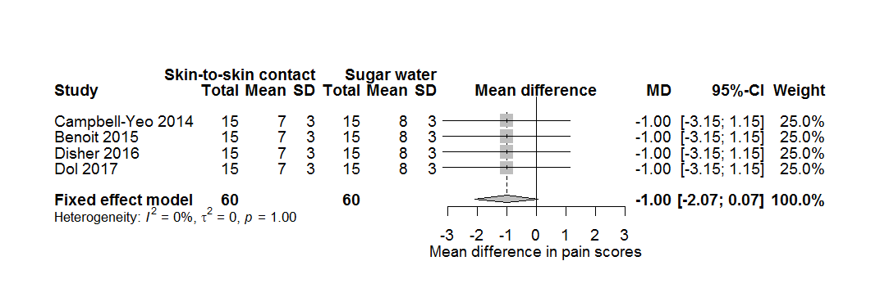
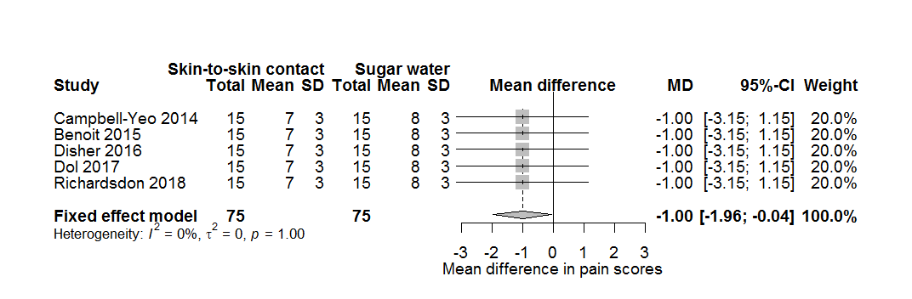
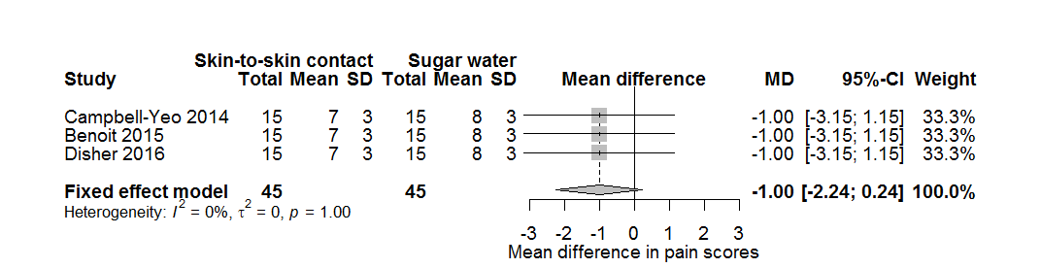
WHY CONDUCT A META-ANALYSIS?
NMA PRIMER
Borenstein, Hedges, Higgins, & Rothstein, 2009

Slide 8
WHAT IF HAD A DIFFERENT QUESTION?
NMA PRIMER
Skin to Skin
Breastfeeding
Sugar water
Notes:
Arrow for direct and indirect

Slide 9
DIRECT AND INDIRECT EVIDENCE
NMA PRIMER
Skin to Skin
Breastfeeding
Sugar water
Notes:
Arrow for direct and indirect

Slide 10
DIRECT AND INDIRECT EVIDENCE
NMA PRIMER
Skin to Skin
Breastfeeding
DIRECT EVIDENCE
Sugar water
Notes:
Arrow for direct and indirect

Slide 11
DIRECT AND INDIRECT EVIDENCE
NMA PRIMER
Skin to Skin
INDIRECT EVIDENCE
Breastfeeding
DIRECT EVIDENCE
Sugar water
Notes:
Arrow for direct and indirect

Slide 12
DIRECT AND INDIRECT EVIDENCE
NMA PRIMER
Skin to Skin
INDIRECT EVIDENCE
Breastfeeding
DIRECT EVIDENCE
Sugar water
Notes:
Arrow for direct and indirect

Slide 13
WHAT CAN NMA ADD?
NMA PRIMER
Rigorous comparison of all available interventions
Improved precision (sometimes)
More opportunities to explore sources of heterogeneity
Guidance for future research
Schwarzer, Carpenter, & Rücker, 2015

Slide 14
ASSUMPTIONS
NMA PRIMER
Skin to Skin
Additional assumptions
Transivity
Consistency
Breastfeeding
Sugar water
Schwarzer, Carpenter, & Rücker, 2015

Slide 15
Basic steps in an NMA
NMA PRIMER
Systematic review
Quality appraisal
Network visualization
Synthesis feasibility
Pairwise meta-analysis
NMA
Exploring heterogeneity
Drawing conclusions
Schwarzer, Carpenter, & Rücker, 2015

Slide 16
BRIEF PRIMER ON BAYESIAN METHODS
NMA PRIMER
NMAs can be conducted using traditional (using R, and STATA) or Bayesian methods
Advantages of Bayesian methods
Most developed (although rapidly changing)
Allow probabilistic statements (e.g. probability an intervention is best)
Logical interpretation of coverage intervals
Theoretically superior treatment of between-trial heterogeneity
Increased flexibility
Disadvantages of Bayesian methods
Time, need to run additional diagnostics
Random effects can “explode” with insufficient data
Requires strong statistical programming skills

Slide 17
REVIEW QUESTION
WHAT IS THE MOST EFFECTIVE PAIN RELIEVING STRATEGY FOR EYE EXAMS IN PRETERM NEONATES?
Notes:
Part of Coursework

Slide 18
METHODS
BAYESIAN NETWORK META-ANALYSIS
P | Preterm infants undergoing ROP eye exam in the NICU
I | Procedure modification or Pharmacological or non-pharmacological pain relieving treatments
C | Active treatment or placebo
O | Primary: Validated pain assessment tools during (pain reactivity) and immediately after (pain recovery) eye exams Secondary: Physiological, behavioural, and adverse event outcomes
S | Randomized controlled trials or randomized crossover trials
Notes:
Part of Coursework

Slide 19
Search Strategy and Critical Appraisal
METHODS
(PROSPERO 2017: CRD42017058231
Search strategy and selection criteria
Pubmed, Embase, Cochrane Central, Web of Science (July 2017)
Quality appraisal Cochrane Risk of Bias Higgins JPT et al., 2011
Publication bias assessed through comparison with trial registries and poster publications
Screening and data extraction by two independent reviewers. Authors contacted if data missing.
Notes:
Part of Coursework

Slide 20
STATISTICAL ANALYSIS
METHODS
Synthesis feasibility assessed visually based on trial characteristics.
Standard error for cross-over trials adjusted based on paired t-test p-value and all assessment scales converted to the PIPP and means imputed from medians if not provided
NMA conducted using a random effects model in JAGS through gemtc, four chains with 20,000 iterations with burn in of 5000.
Convergence monitored with standard measures and plots
Code adjusts for correlation in multi-arm trials, estimates a common between-trial heterogeneity parameter, and uses vague priors.
Notes:
Part of Coursework

Slide 21
STATISTICAL ANALYSIS
METHODS
Continuous outcomes expressed as mean difference with 95% credible interval, adverse events as odds ratios.
Surface under the cumulative ranking (SUCRA) calculated to express the probability that a treatment is optimal.
Consistency assessed using an inconsistency model, supplemented with visual inspection of pairwise and NMA plots.
Meta-regression explored based on: baseline risk, scaled score, imputed mean, birthweight, gestational age, risk of bias
Model fit assessed following NICE recommendations
Notes:
Part of Coursework

Slide 22
STATISTICAL ANALYSIS
METHODS
Pain reactivity and recovery converted to absolute scores using the largest trial as a baseline.
Used to create icon arrays for top three treatments as ranked by SUCRA
Calculate probability that absolute score is below a threshold
Notes:
Part of Coursework

Slide 23
RESULTS
PRISMA GOES HERE

Slide 24
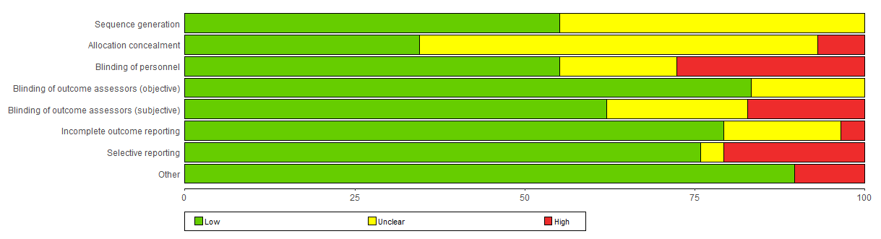
Risk of Bias
RESULTS
Typical challenges with unclear responses for sequence generation and allocation concealment

Slide 25
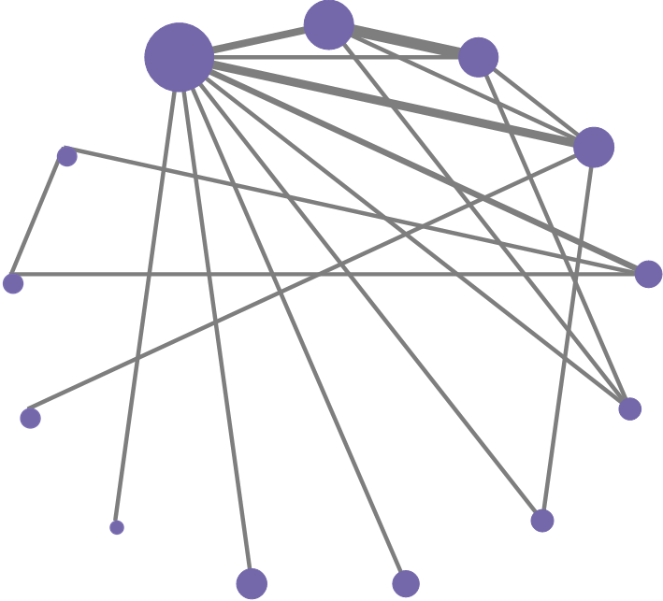
RESULTS
PAIN REACTIVITY
PAIN RECOVERY
ADVERSE EVENTS
●
●
●

Slide 26
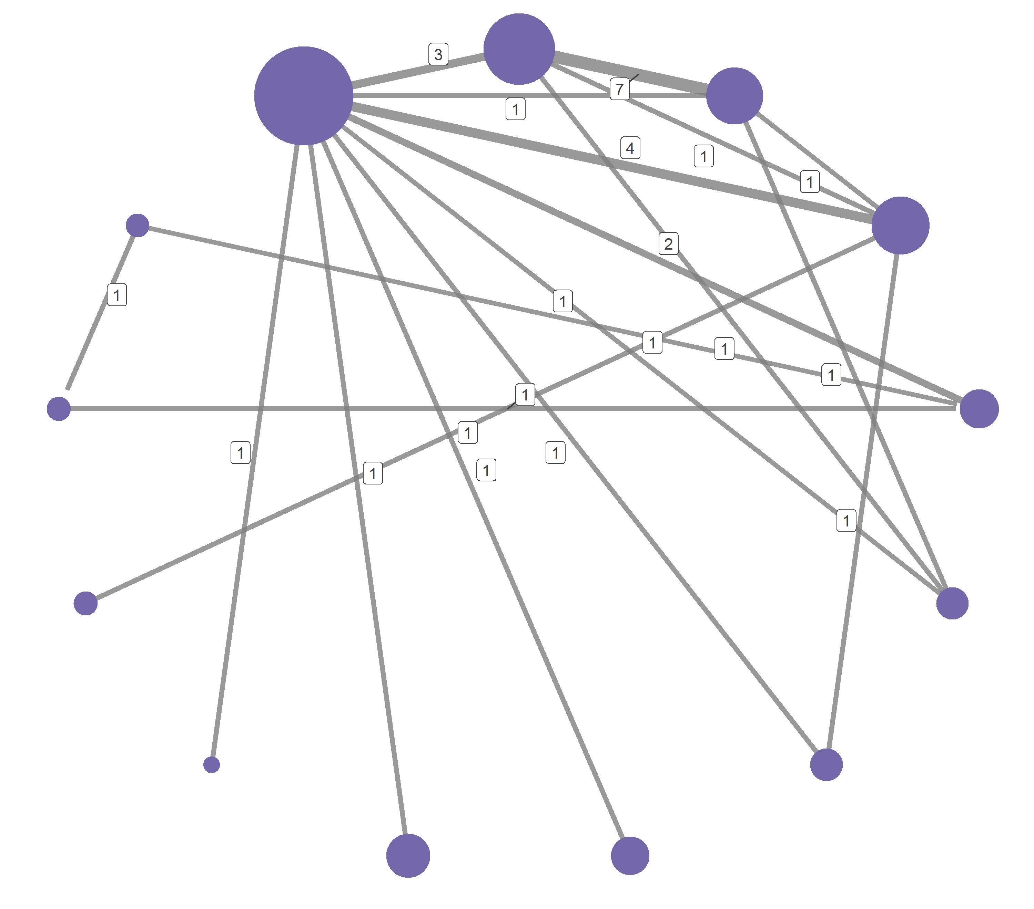
RESULTS – PAIN REACTIVITY
Topical Anesthetic (TA)
Sweet multisensory + TA
NNS + TA
Sweet + singing
Sweet taste + TA
PAIN REACTIVITY
Sweet repeated
No treatment
Sweet taste + N02 + TA
EBMmultisensory + TA
Sweet taste
Acetaminophen 30m + TA
WFDRI + TA
Acetaminophen 60m + TA
Notes:
20 studies (n = 1228) with data that could be included in meta-analysis
13 treatments

Slide 27
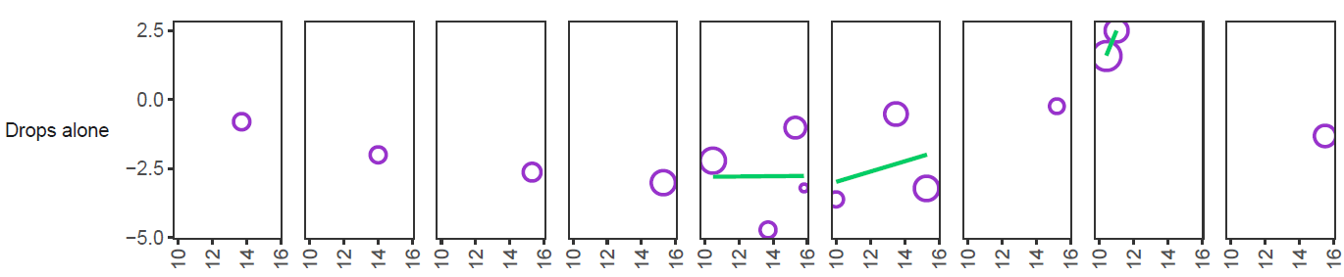
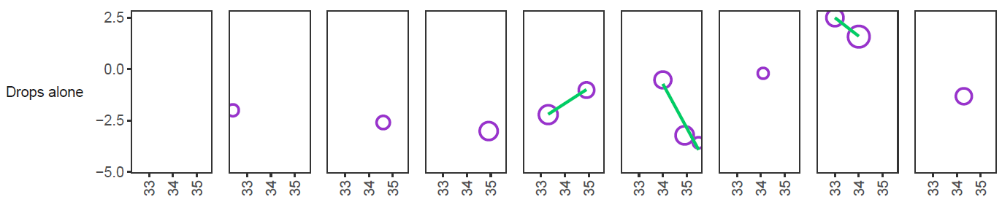
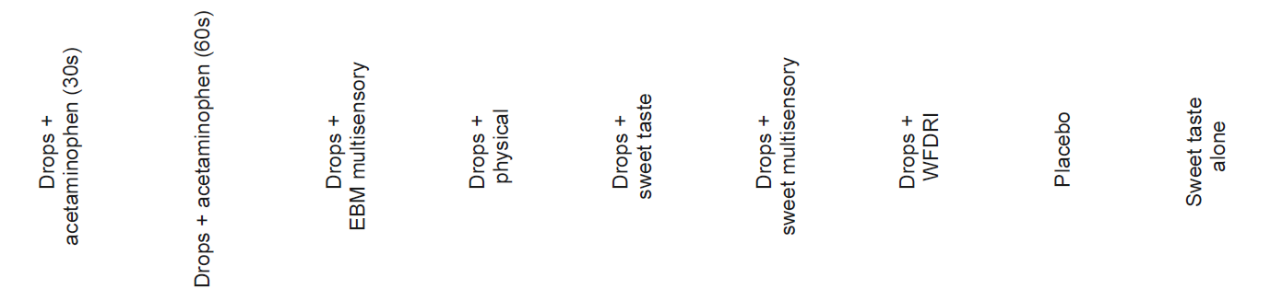
Participant characteristics
RESULTS – PAIN REACTIVITY
SYNTHESIS FEASIBILITY
Treatment effect
Baseline PIPP score
Postmenstrual age

Slide 28
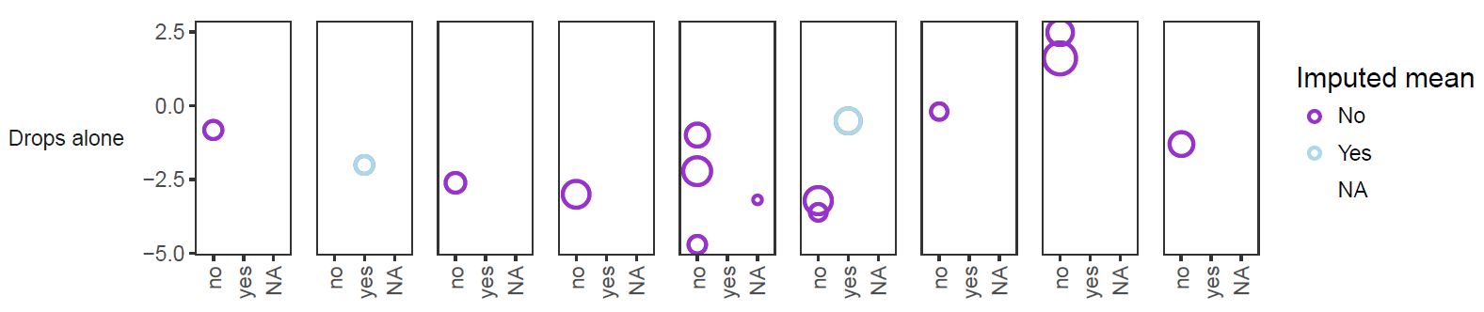
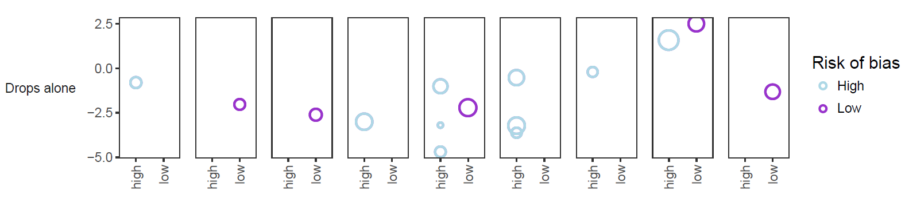
Study Characteristics
RESULTS – PAIN REACTIVITY
SYNTHESIS FEASIBILITY
Imputed mean
Treatment effect
Risk of Bias

Slide 29
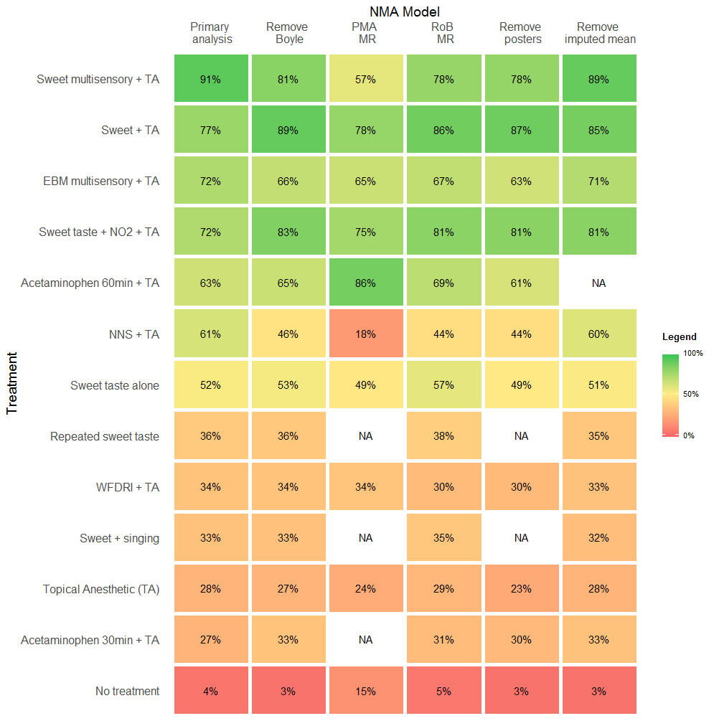
RESULTS – PAIN REACTIVITY
Inconsistency detected in one comparison.
Trial was very high risk of bias and inaccessible to meta-regression
Removal reduced between-trial SD (1.32 to 1.12)
Best fitting model was Boyle removed and imputed means removed
INCONSISTENCY

Slide 30
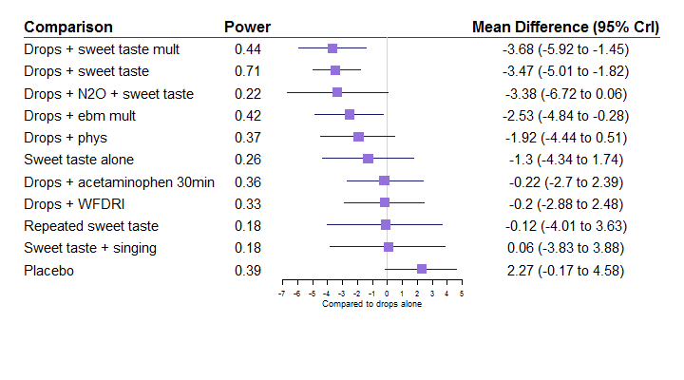
PIPP Reactivity vs Topical Anesthetic
RESULTS – PAIN REACTIVITY
Probability that difference between top two treatments is at least 2 points = 12.8%
RELATIVE EFFECTS

Slide 31
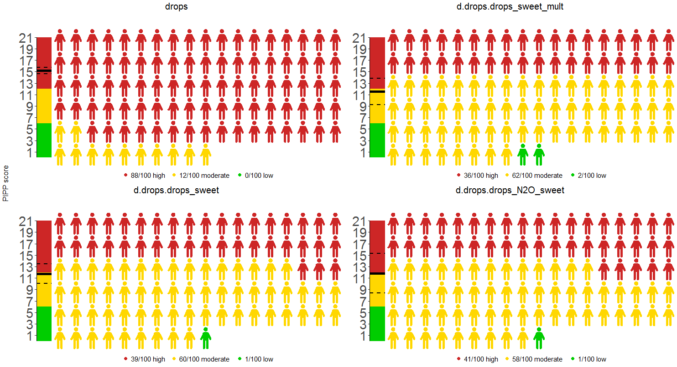
RESULTS – PAIN REACTIVITY
Probability that mean absolute score <= 6 less than 1%
ABSOLUTE SCORES

Slide 32
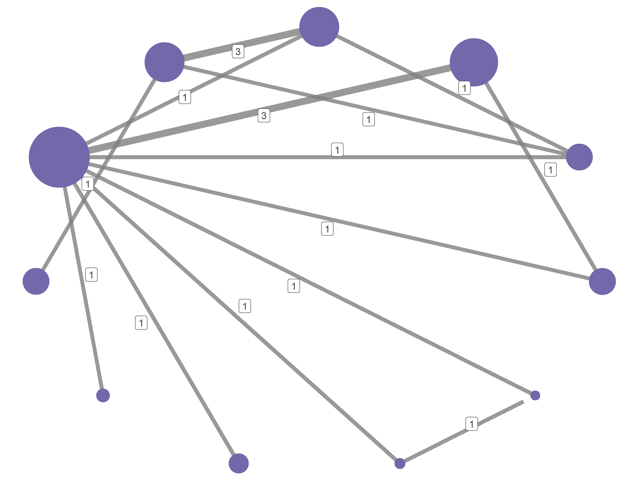
RESULTS – PAIN RECOVERY
Sweet multisensory + TA
NNS + TA
Sweet taste + TA
Sweet + singing
Topical Anesthetic (TA)
EBM multisensory + TA
PAIN RECOVERY
Acetaminophen 30m + TA
NNS
Sweet taste
Acetaminophen 60m + TA
No treatment
Morphine + TA

Slide 33
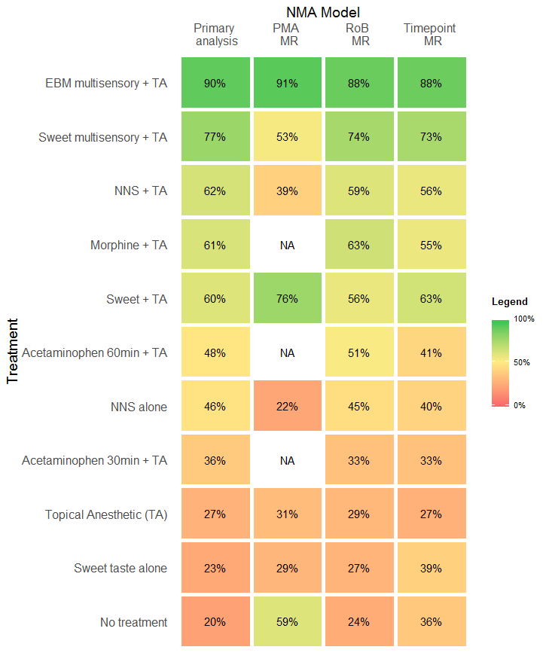
RESULTS – PAIN RECOVERY
No inconsistency
Primary analysis was best fitting model
INCONSISTENCY

Slide 34
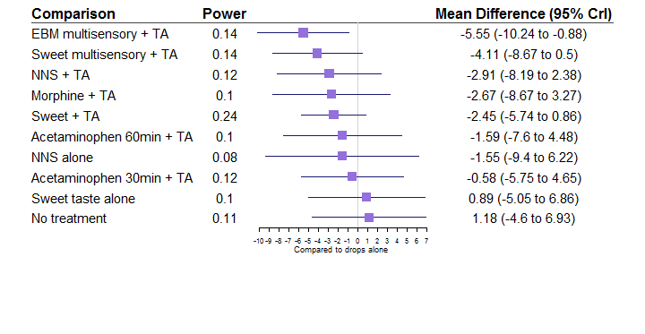
PIPP Recovery vs Topical Anesthetic
RESULTS – PAIN RECOVERY
Probability that difference between top two treatments is at least 2 points = 12.8%
RELATIVE EFFECTS

Slide 35
RESULTS – PAIN RECOVERY
Probability that mean absolute score <= 6 less than 1%
ABSOLUTE SCORES

Slide 36
PIPP Recovery
RESULTS – PAIN RECOVERY
Inconsis

Slide 37
All treatments – Best model
RESULTS – PAIN RECOVERY
Inconsis

Slide 38
LIMITATIONS
Meta-regressions likely underpowered
Inconsistent loop complicates interpretation
Reactivity/Recovery split not ideal

Slide 39
CONCLUSIONS
Network Meta Analysis is a powerful tool under the right conditions
Interpretation can be complex
Assumptions might otherwise go un-checked

Slide 40
REFERENCES
Borenstein, M., Hedges, L. V., Higgins, J. P. T., & Rothstein, H. R. (2009). Introduction to Meta-Analysis. https://doi.org/10.1002/9780470743386.fmatter
Higgins JPT, Altman DG, Gøtzsche PC, Jüni P, Moher D, Oxman AD, … JAC. (2011). The Cochrane Collaboration’s tool for assessing risk of bias in randomised trials. . British Medical Journal, 343, 889–893. https://doi.org/doi: 10.1136/bmj.d5928
Schwarzer, G., Carpenter, J. R., & Rücker, G. (2015). Meta-Analysis with R. https://doi.org/10.1007/978-3-319-21416-0
Stevens, B., Johnston, C., Taddio, A., Gibbins, S., & Yamada, J. (2010). The Premature Infant Pain Profile: Evaluation 13 Years After Development. The Clinical Journal of Pain, 26(9), 813–830. https://doi.org/10.1097/AJP.0b013e3181ed1070

Slide 41

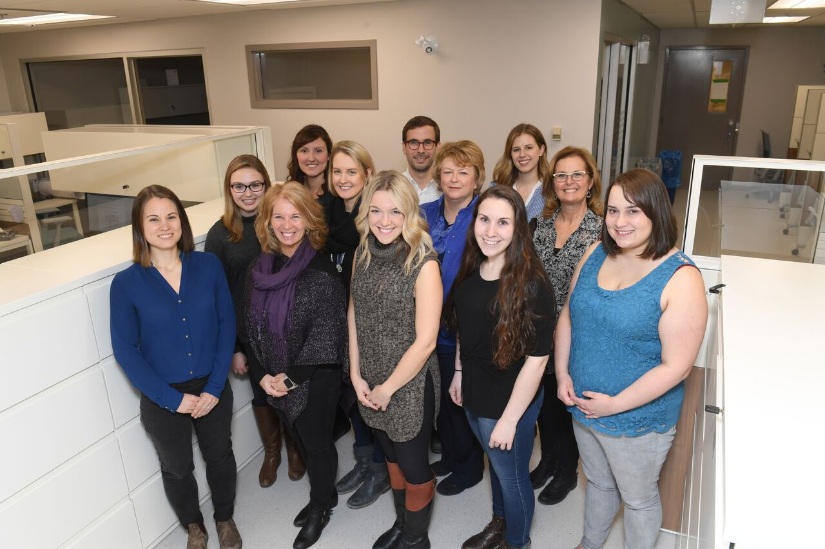



Acknowledgements
Special thanks to the MOM-LINC lab and funders for ongoing support

Slide 42
Appendices
MEDLINE Search Strategy
Ovid MEDLINE(R) Epub Ahead of Print, In-Process & Other Non-Indexed Citations, Ovid MEDLINE(R) Daily and Ovid MEDLINE(R)
1. Retinopathy of Prematurity/
2. exp Ophthalmoscopy/
3. retinopath*.tw.
4. retrolental fibroplasia?.tw.
5. ophthalmoscop*.tw.
6. (scleral adj (depress* or indent*)).tw.
7. 1 or 2 or 3 or 4 or 5 or 6
8. exp Infant, Newborn/
9. ((prematur* or pre-matur* or preterm* or pre-term*) adj2 (infant* or newborn? or baby or babies or neonat* or neo-nat* or child*)).tw.
10. (premie? or preemie?).tw.
11. (low adj2 (birthweight? or birth weight?)).tw.
12. (small adj2 gestation* age).tw.
13. 8 or 9 or 10 or 11 or 12
14. exp Pain/
15. Pain Management/
16. Pain Measurement/
17. exp Analgesia/
18. exp Analgesics/
19. Anesthetics, Local/
20. pain*.tw.
21. analgesia.tw.
22. analgesic?.tw.
23. (local* adj2 anesthetic?).tw.
24. comfort*.tw.
25. discomfort*.tw.
26. stress*.tw.
27. sooth*.tw.
28. (pacify* or pacifie*).tw.
29. 14 or 15 or 16 or 17 or 18 or 19 or 20 or 21 or 22 or 23 or 24 or 25 or 26 or 27 or 28
30. 7 and 13 and 29

Slide 43
NMA Exclusion reasons
Author/Year | Sample size | Treatment | Excluded from | Reason
Olson 2011 | 29 | TA + sweet vs TA | PIPP reactivity | Does not use speculum
Ucar 2014 | 81 | TA + NNS vs TA + sweet vs TA + sweet + mult | PIPP reactivity | No variance info

